Slide 1

Mobile Application Development
Welcome
Class: BS(CS)-VII
Sukkur IBA University – Kandhkot Campus
Week - 01
Lecture – 01 & 02
Your Facilitator, Adil Khan

Slide 2

About Course

Slide 3
Learning Outcomes
 | Course Learning Outcomes (CLO)
1 | Design and develop Android device-specific, native applications
2 | Describe the components and structure of a mobile development framework (Google’s Android Studio)
3 | Integrate database and server-side technologies to provide complete mobile development solutions
4 | Analyze the working of android code.

Slide 4
Recommended Books
Android Programming - The Big Nerd Ranch Guide (3rd Edition)
By Bill Phillips
The Busy Coder’s Guide to Android Development (Final Version)
By Mark L. Murphy
Head First To Android Development
By Orie’lly

Slide 5
Grading Policy
Theory | Marks
Mid – I | 20 %
Mid – II | 20 %
Assignment & Quiz | 10 %
Project | 10%
Final | 40 %
Total | 100 %

Slide 6


Slide 7
What is Mobile Computing?
A technology that allows transmission of data, via a computer, without having to be connected to a fixed physical link.
Mobile voice communication is widely established throughout the world and has had a very rapid increase in the number of subscribers to the various cellular networks over the last few years.

Slide 8
Why Mobile Computing?
People are mobile
Devices are mobile

Slide 9
What is mobility?
A person who moves
Between different geographical locations
Between different networks
Between different communication devices
Between different applications
A device that moves
Between different geographical locations
Between different networks

Slide 10
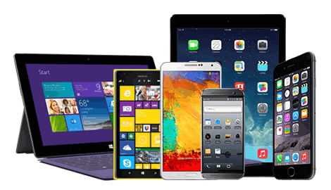
Mobile Computing Devices

Slide 11
Mobile Application Development (MAD)

Slide 12
Why MAD?
Covid-19
In Q3 of 2020 alone, 33 billion new apps were downloaded globally, according to a recent report.
Mobile users worldwide have spent 180 billion collective hours each month of the third quarter, with a huge spend of $28 billion on technology apps.
Undoubtedly, the pandemic would have a lasting impact on mobile app development trends and technologies going forward, just like how it transformed the consumer mobile behavior.
Notes:
The COVID-19 forced social distancing and lockdown policies are driving a steady rise in mobile usage. In Q3 of 2020 alone, 33 billion new apps were downloaded globally, according to a recent report. Mobile users worldwide have spent 180 billion collective hours each month of the third quarter, with a whopping spend of $28 billion on technology apps. Undoubtedly, the pandemic would have a lasting impact on mobile app development trends and technologies going forward, just like how it transformed the consumer mobile behavior.
It is true that a well engaging and standout business app will enhance branding and retain customers. Every business that wants to sell its products, extend assistance, offer service, or share information will definitely strive to make its mobile app user-friendly and accessible to customers. Besides identifying how your mobile application will function or what resources you’ll require, it’s important to figure out which mobile development platforms or technology in mobiles will serve your needs better.

Slide 13
Five Major Programming Languages

Slide 14
Swift
If you are building something specific to Apple OS (native to Apple), Swift is the language to seek.
Swift is a popular iOS application development language that offers advanced features with minimal coding that can be easily maintained.

Slide 15
C++
C++ forms the simplistic base for most of the programming languages and possesses the power to create dynamic technology apps.
C++ is highly required after today to develop multi-platform apps. You can write code in C++ to develop the application once and use it on different platforms (Android, iOS, and Windows) without sacrificing the app’s performance or security.
Its sister language, Objective-C, was earlier used for app development in Apple systems, prior to the introduction of Swift in 2014.

Slide 16
Java
Since the introduction of Android in 2008, this object-oriented programming language has been the popular and official language for Android mobile app development.
An extremely versatile language, Java helps keep your app flexible, modular, and extensible.
Java is easy to handle and many open source libraries are made available for users to choose from.

Slide 17
HTML5
There is no better technology to use than HTML5 if your organization is looking at developing web-frontend applications for mobile devices.
Organizations that consider cross-platform mobile app development as a scary task often choice to HTML5 as it helps you deliver the right functionality and exceptional user experience.
The “write-once-run-anywhere” advantage offered by HTML5 accelerates your time to market, improves your app’s visibility, makes development affordable, and supports offline browsing.

Slide 18
PHP5
A rather easy language to learn, PHP is object-oriented and uses a three-layered model to help create dynamic mobile apps and web applications.
It is highly suitable for apps that require database integration.
Popular PHP frameworks such as Laravel, Lumen, CodeIgniter, and Symfony are being used extensively for building mobile apps that require complex backend and exhaustive data migration.

Slide 19
Tools for building Mobile Apps

Slide 20
PhoneGap
PhoneGap, also known as Apache Cordova, is an open-source mobile app development framework that uses CSS3, HTML5, and JavaScript, to create native applications for Android, Windows, and iOS.
This framework allows mixing native and hybrid code snippets which results in apps that are neither truly native mobile nor web-based applications.

Slide 21
Appcelerator
This open-source framework is the best choice to develop hardware-based apps.
The framework uses HTML, PHP, and JavaScript to create native apps for iOS, Android, and Universal Windows Platform (UWP).

Slide 22
RhoMobile
RhoMobile Suite is based on the powerful Rhodes open-source framework that supports native app development for multiple platforms.
It’s highly used to build cross platform and native consumer and enterprise mobile applications.
RhoMobile uses web technologies like CSS3, HTML5, JavaScript, and Ruby to build apps for most of the operating systems including iOS, Android, and Windows.

Slide 23
WidgetPad
WidgetPad is one of the best open-source frameworks for cross platform mobile application development.
It uses web technologies like JavaScript and HTML5 to offer a multitude of options like source code editing, versioning, and distribution.
This open-source framework enables developing applications for platforms like Android, iOS, and web.

Slide 24
MoSync
MoSync is an open-source multi-platform mobile app development kit that utilizes programming languages such as JavaScript, PHP, Ruby, and Python.
It is integrated with Eclipse-based IDE and enables native mobile app development for multiple platforms using C/ C++ programming.

Slide 25
Leading mobile application development frameworks

Slide 26
Flutter
Flutter is the new trending cross-platform mobile application development technology in town. It uses “Dart” as a programming language instead of JavaScript which facilitates rapid and effective analysis, fabricates UIs, includes highlights and fixes bugs in milliseconds.
The open source cross-platform SDK by Google extends a wide range of plugins backed by Google and allows mobile apps to be built for both Android and Apple iOS platforms.

Slide 27
React Native
This JavaScript open-source framework has become the most preferred native mobile app development technology.
It offers ample support to IDEs and other mobile app development tools and enables the development of native apps for iOS and Android platforms.
ReactNative framework allows to build native mobile apps with JavaScript, using the same design as React.
Apps built using React Native are real mobile apps, that cannot be distinguished from an app built using Objective-C or Java or Swift.

Slide 28
Ionic
Ionic uses the HTML5 programming language and is widely preferred for mobile app development today.
It combines HTML, CSS3, and JavaScript to build native apps and create their UI functionalities with ease.
This mobile app development technology works on iOS’s UIWebView or Android’s WebView.
Ionic is built on top of Angular JS and Apache Cordova. Ionic is the easiest way for web developers to build, grow, and scale cross-platform mobile apps.

Slide 29
Xamarin
This cross-platform framework with coding advantages of C# uses single code across iOS, Android, Windows, and other platforms.
With the benefits of code sharing, Xamarin builds applications that render exact native app experience.
It is the most time and cost saving framework for mobile app development.
Xamarin allows you to deliver native Android, iOS, and Windows apps with a single shared .NET code base.
The framework offers access to the full spectrum of functionality exposed by the underlying platform and device, including platform-specific capabilities.

Slide 30
Felgo
Felgo, previously known as V-Play Engine is a popular cross-platform development framework used to create mobile games and apps.
Felgo uses Qt as its core framework which simplifies the development of games and apps. With Felgo, you can create flexible and modern apps compiled natively from a single code-base for Android, iOS, Desktop, Web, and Embedded platforms.

Slide 31
Mobile Angular UI
Mobile Angular UI is an open source mobile framework that combines the best features of Angular js and Bootstrap 3 syntax, including the missing components of Bootstrap.
It provides fresh UI components such as navbar, sidebars, modals and overlays, switches, etc. Since it makes use of Angular js and Bootstrap, it’s easy for developers to learn the framework and get started.
Mobile Angular UI allows businesses to build HTML5 hybrid mobile and desktop apps with less effort.

Slide 32
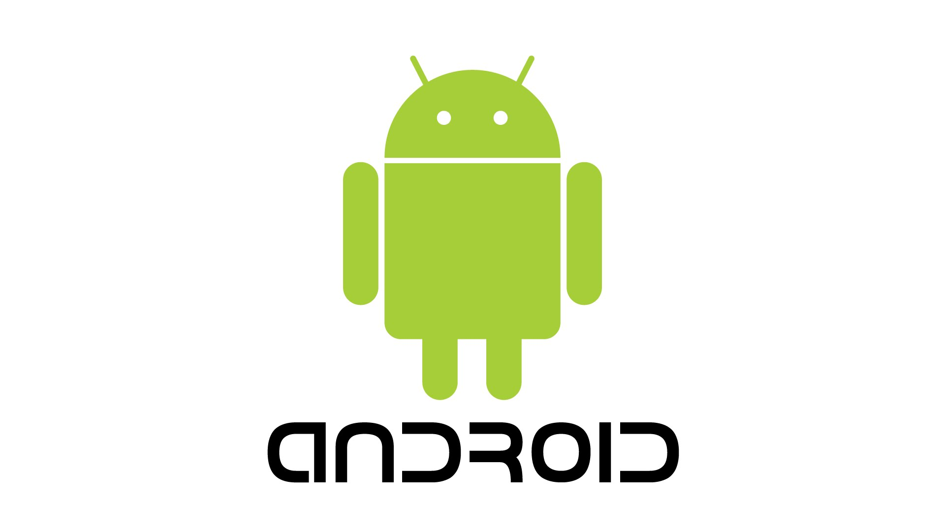
Let’s start Android Development

Slide 33
Introduction
Android is an open source operating system and software toolkit
Designed primarily for mobile phones, it was created by Google and the Open Handset Alliance.
Runs on about 3 billion devices as of 2021

Slide 34
Introduction
Open-source, free development platform based on Linux
It is popular among handset makers because they can customize the platform.
Several built-in services like GPS (or location-based services), built-in SQL-based database called SQLite

Slide 35
Introduction
Automatic management of the application life cycle
Programs are isolated from each other by multiple layers of security
Optimized for low-power, low-memory devices
Supports high-quality graphics and sound: 2D vector graphics, animations, and 3D accelerated OpenGL graphics for creating games

Slide 36
Introduction
Portability across a wide range of hardware
All your programs are written in Java or Kotlin, and executed by Android’s Dalvik virtual machine (DVM)
Code will be portable across ARM, x86, and other architectures

Slide 37
A Brief History
The history of Android begins in October 2003
Android Inc was founded in Palo Alto, California by its four founders Rich Miner, Nick Sears, Chris White, and Andy Rubin
In 2005, Google acquired Android Inc
Linux was chosen as the basis for the Android OS.

Slide 38
A Brief History
The OS was offered to third-party mobile phone manufacturers for free
The company could make money offering other services that used the OS, including apps.
In 2007, Apple launched the first iPhone, but Google was still working on Android

Slide 39
A Brief History
Google and phone maker companies, like HTC and Motorola, chip manufacturers such as Qualcomm and Texas Instruments, and carriers including T-Mobile, formed the Open Handset Alliance.
The public beta of Android version 1.0 launched for developers on Nov. 5, 2007.

Slide 40
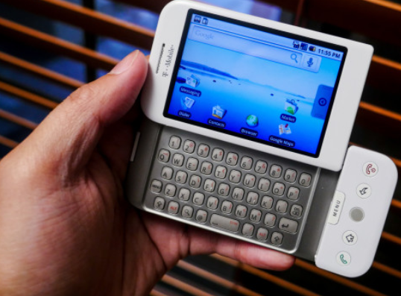
A Brief History
In September 2008, the very first Android smartphone was announced: the T-Mobile G1, also known as the HTC Dream

Slide 41
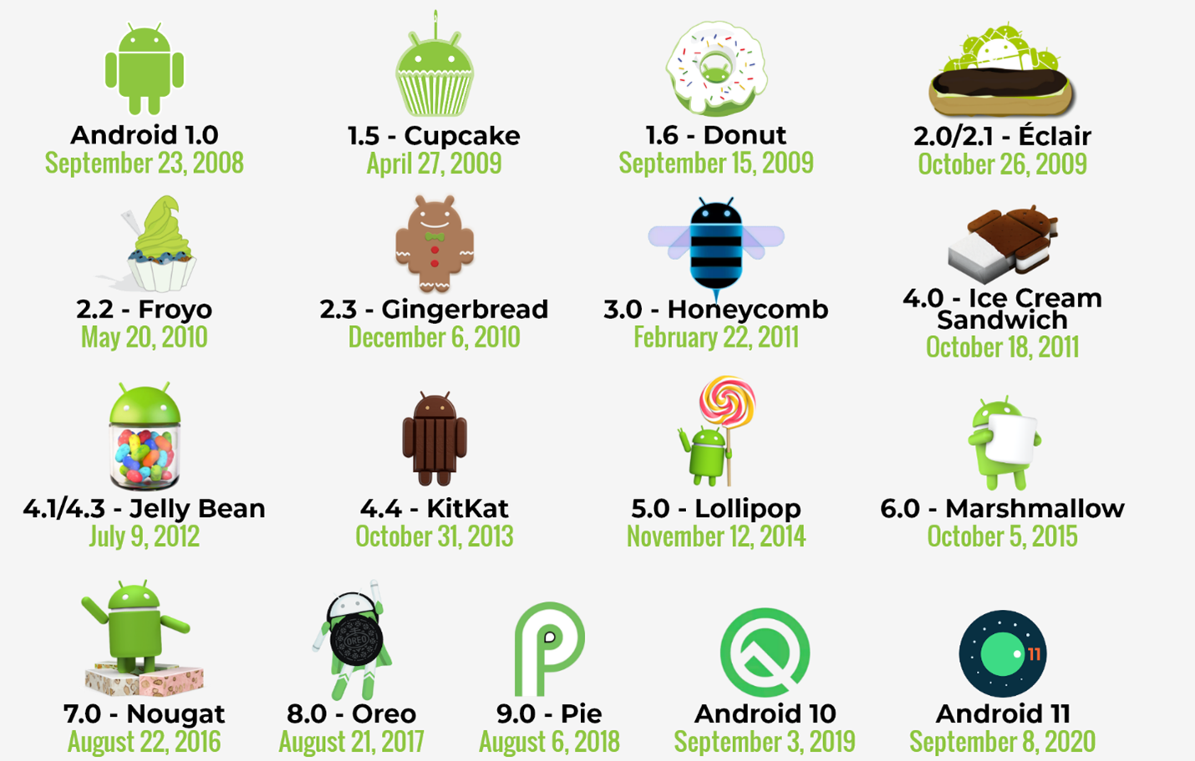
Android Versions

Slide 42
Necessary Tools
Android Studio
An install of Android Studio includes:
Android SDK: the latest version of the Android SDK
Android SDK tools and platform tools: tools for debugging and testing your apps
A system image for the Android emulator
lets you create and test your apps on different virtual devices

Slide 43
Necessary Tools
We will be using the version 3.1 of Android Studio
Download for Windows
Download for macOS
Download for Linux

Slide 44
Necessary Tools
We will be using Java as the programming language

Slide 45
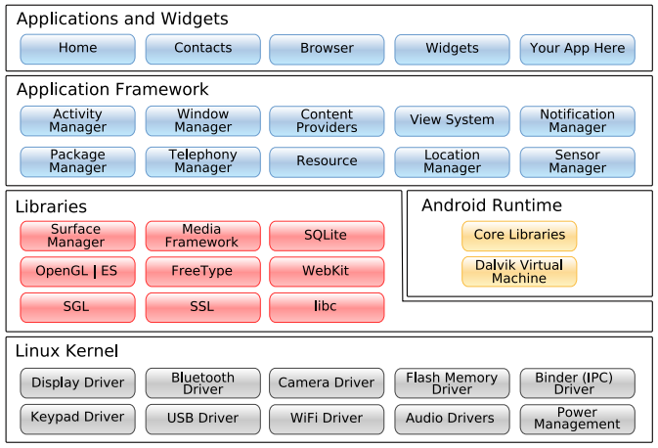
Android System Architecture

Slide 46
Android System Architecture
Linux Kernel
Android uses Linux for its memory management, process management, networking, and other operating system services.

Slide 47
Android System Architecture
Native Libraries
Written in C or C++, compiled for the particular hardware architecture used by the phone, and preinstalled by the phone vendor.
Some of them include
Surface Manager: Android uses a compositing window manager similar to Windows Vista that lets it create effects such as see-through windows and fancy transitions.

Slide 48
Android System Architecture
2D and 3D graphics
Create 2D or 3D (if device supports) elements. Helpful in developing games.
Media codecs
For playing and recording video and audio in a variety of formats like MP3, and MPEG-4, AVC etc.

Slide 49
Android System Architecture
SQLite database
A lightweight database engine used for persistent storage in your application.
Browser engine
For the fast display of HTML content, Android uses the WebKit library.
This is the same engine used in the Google Chrome browser, Apple’s Safari browser, the Apple iPhone, and Nokia’s S60 platform.

Slide 50
Android System Architecture

Slide 51
Android System Architecture
Android Runtime
Includes the Dalvik virtual machine (DVM) and the core Java libraries.
Your code gets compiled into machine-independent instructions called bytecodes, which are then executed by the Dalvik VM on the mobile device.
Although the bytecode formats are a little different, Dalvik is essentially a Java virtual machine optimized for low memory requirements.

Slide 52
Android System Architecture
Android Runtime
Dan Bornstein (its developer at Google) named it after a fishing village in Iceland where some of his ancestors lived.
The Dalvik VM runs .dex (stands for Dalvik Executable) files, which are converted at compile time from standard .class and .jar files.
.dex files are more compact and efficient than class files, designed for the limited memory and battery-powered devices

Slide 53
Android System Architecture

Slide 54
Android System Architecture
Application Framework
This layer provides the high-level building blocks you will use to create your applications.
The most important parts are:
Activity Manager: This controls the life cycle of applications
Content Providers: These objects encapsulate data that needs to be shared between applications, such as contacts.
Resource manager: Resources are anything that goes with your program that is not code like images, mp3 files etc.

Slide 55
Android System Architecture
Application Framework
The most important parts are:
Location manager: GPS etc. used to tell the current location of the device
Notification manager: Notifies about the incoming messages and alerts etc.
Our apps can access/use these components.

Slide 56
Android System Architecture

Slide 57
Android System Architecture
Applications and Widgets
End users will see only these programs
Applications are programs that can take over the whole screen and interact with the user (like phone dialer, email app, browser, contacts, play store etc.)
On the other hand, widgets (which are sometimes called gadgets), operate only in a small rectangle of the Home screen application.

Slide 58
Thank you!
Any Questions???

